Slide 1
PASSIVE RADIATIVE COOLING
Team: Passive People
Logan Yeoman
Project Manager & Test Engineer
Sabin Wright
Logistics & Financial Manager
Anubhav Kothari
CAD & Website Engineer
Tori Smith
Manufacturing Engineer
ME – 486C – Project 13

Slide 2
What is passive radiative cooling
Project Description
  Cooling water below ambient temperatures with the purpose of cooling an environment.
  Utilizing the unique wavelengths of UV rays to reflect sunlight and take advantage of outer space’s lower-temperature environment.
  Decreasing the heat produced into the atmosphere using more sustainable techniques like passive cooling.
Client and Sponsors
  Dr. Jennifer Wade: Great Passion for the topic & career-based experience in this subject.
  NAU Green Fund: Additional project funding & assistance in NAU's climate goals.
  Developer : Donation of cutting-edge passive radiative cooling paint.

Slide 3
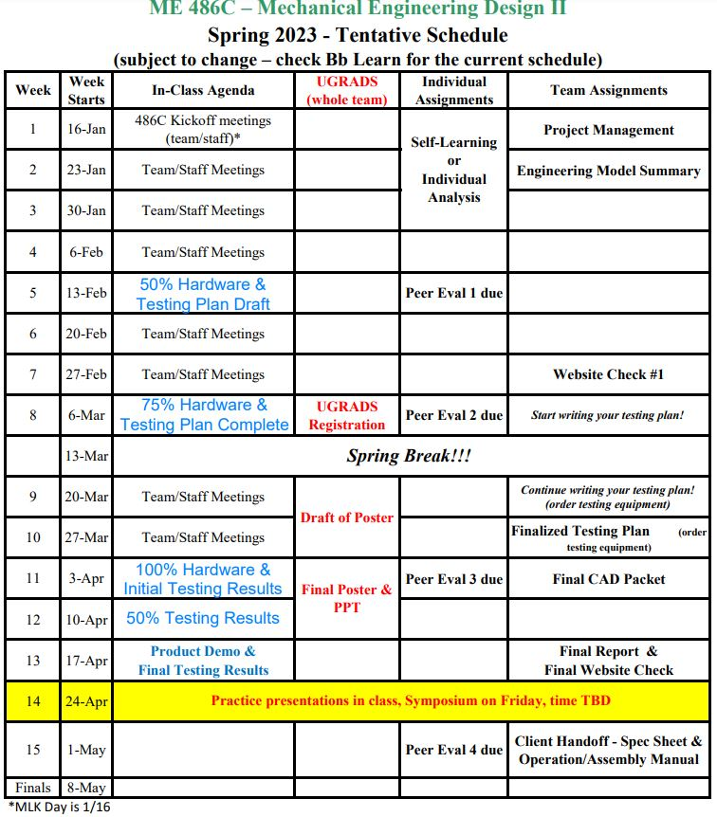
Class Expectation Adjustments
Logan Yeoman - Slide 3
Key Adjustments
First Hardware Update
Original: Hardware Status Update - 33% build
Updated: 50% Hardware & Testing Plan Draft
Second Hardware Update
Original: Hardware Status Update - 67% build
Updated: 75% Hardware & Testing Plan Complete
Third Hardware Update
Original: Hardware Status Update - 100% build
Updated: 100% Hardware & Initial Testing Results
Initial Testing
Original: Initial Testing Results
Updated: 50% Testing Results

Slide 4


Engineering Model Update
$$A_{TOP}=W ∙L$$
$$q_{sink}= Q_{claimed} ∙ A_{TOP}$$
$$A_{{xs}_{channel}}= h_{channel} ∙ w_{channel}$$
$$D_{hydraulic}= \frac{(4)(A_{{xs}_{channel}})}{(\left(2\right)\left(h_{channel}+w_{channel}\right))}$$
$$\dot{m}= \frac{q_{sink}}{{Cp}_{H2O}∙ {∆T}_{Target}}$$
$V= \frac{\frac{\dot{m}}{ρ_{H2O}}}{A_{{xs}_{channel}}}$
$Re= \frac{(ρ_{H2O})(V)(D_{hydraulic})}{μ_{H2O}}$
$h_{internal}= \frac{(Nu)(k_{H2O})}{D_{hydraulic}}$
$l_{minimum}= \frac{\frac{\frac{q_{sink}}{h_{internal}}}{w_{channel}}}{{∆T}_{target}}$
Results
Description | Variable | Value | Units
Panel Area | Atop = | 0.0929 | m^2
Heat Removed | qsink = | 9.2903 | W
Channel Cross Sectional Area | Axs_channel = | 2.90E-05 | m^2
Hydraulic Diameter | D_hydraulic = | 0.0039 | m
Mass Flow Rate | mdot = | 0.4426 | kg/s
Velocity | V = | 15.2454 | m/s
Reynolds Number | Re = | 4.52E+04
Heat Transfer Coefficent | h_internal | 660.9239
Minimum Channel Length | l_minimum | 0.2214 | m
Logan Yeoman - Slide 4

Slide 5
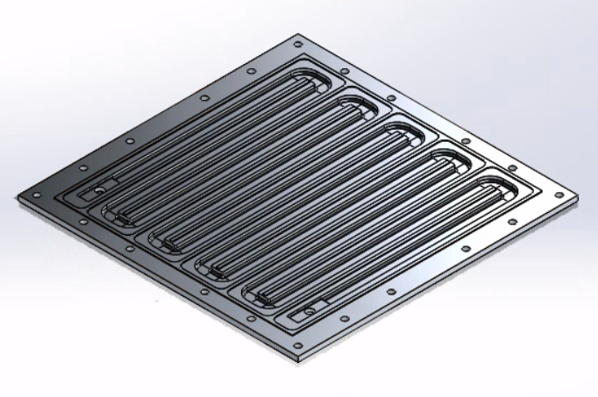
CAD model
Our most recent update on CAD.
The material used is Multipurpose 6061 Aluminum.
The top plate is screwed on which creates a sealing.
Gasket goes between both top plate and the bottom plate.
Panel

Slide 6
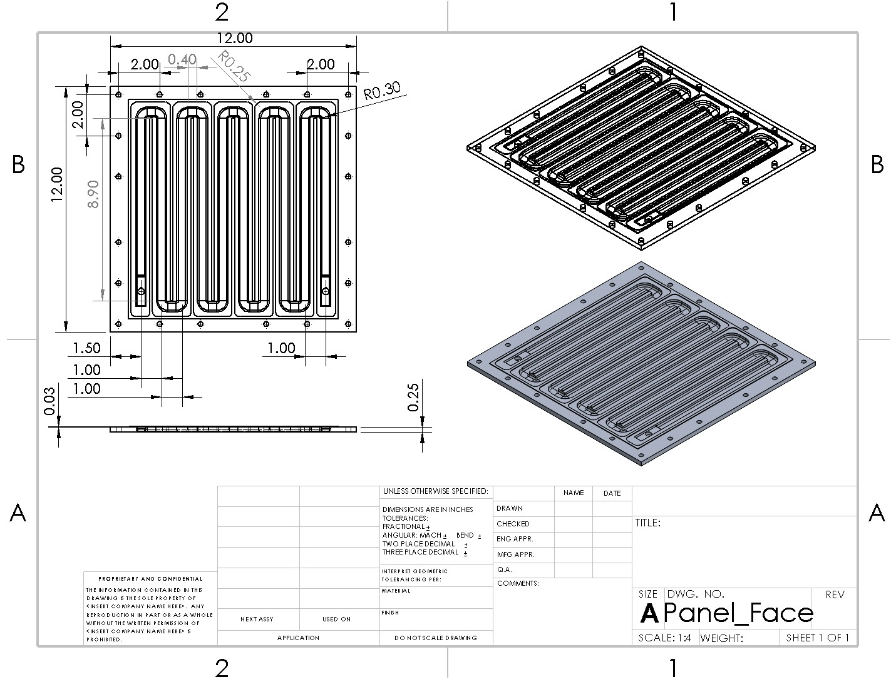
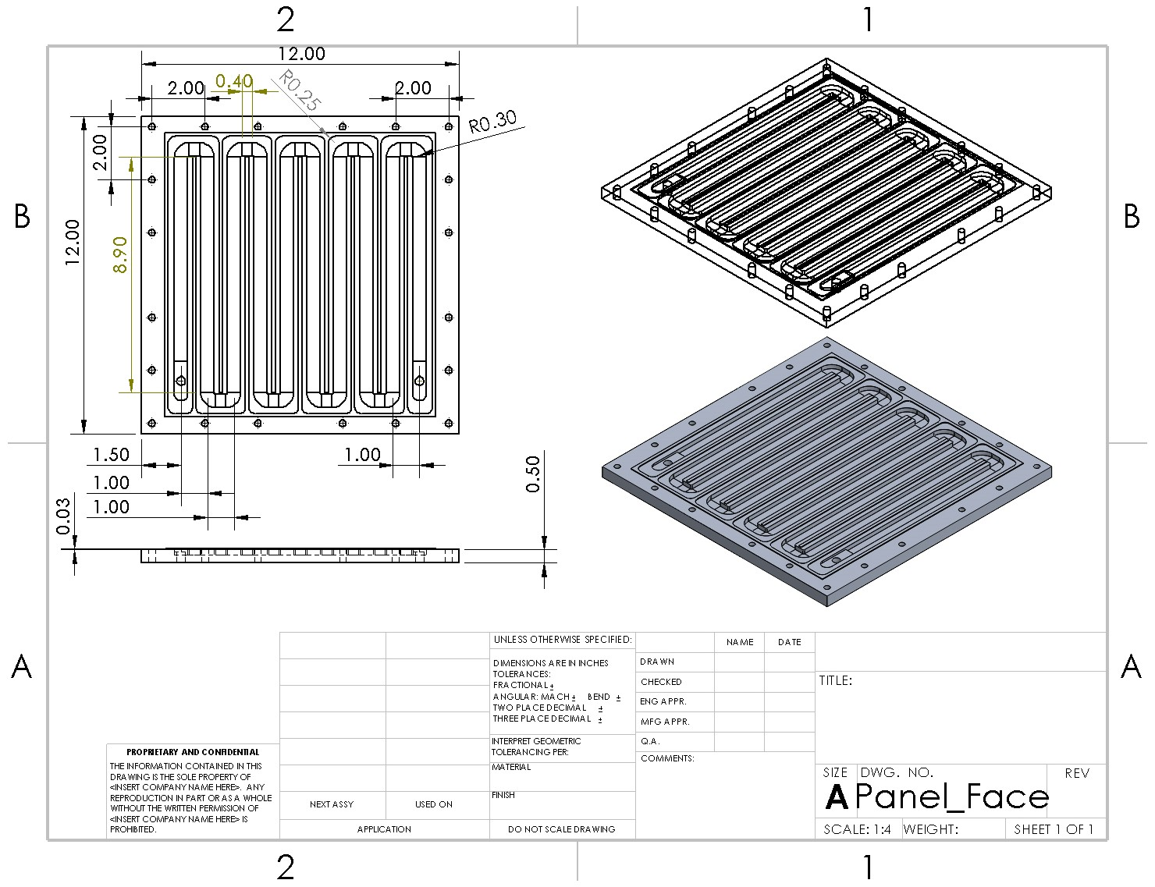
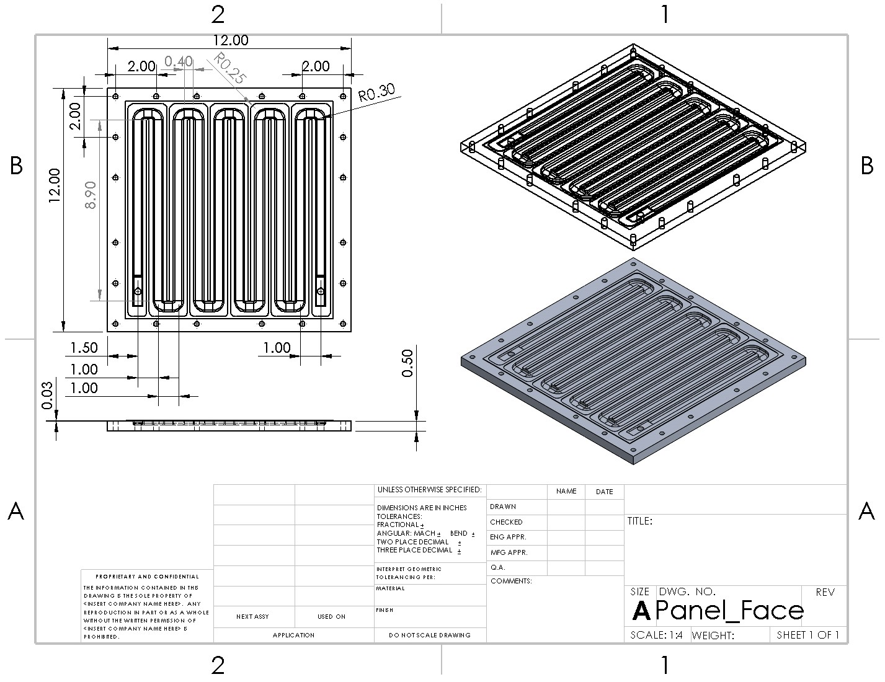
Design Iterations
V2: 0.5in Thick Aluminum
V1: 0.25in Thick Aluminum
V3: Removal of some filets for decreased CNC times
Logan Yeoman - Slide 6

Slide 7
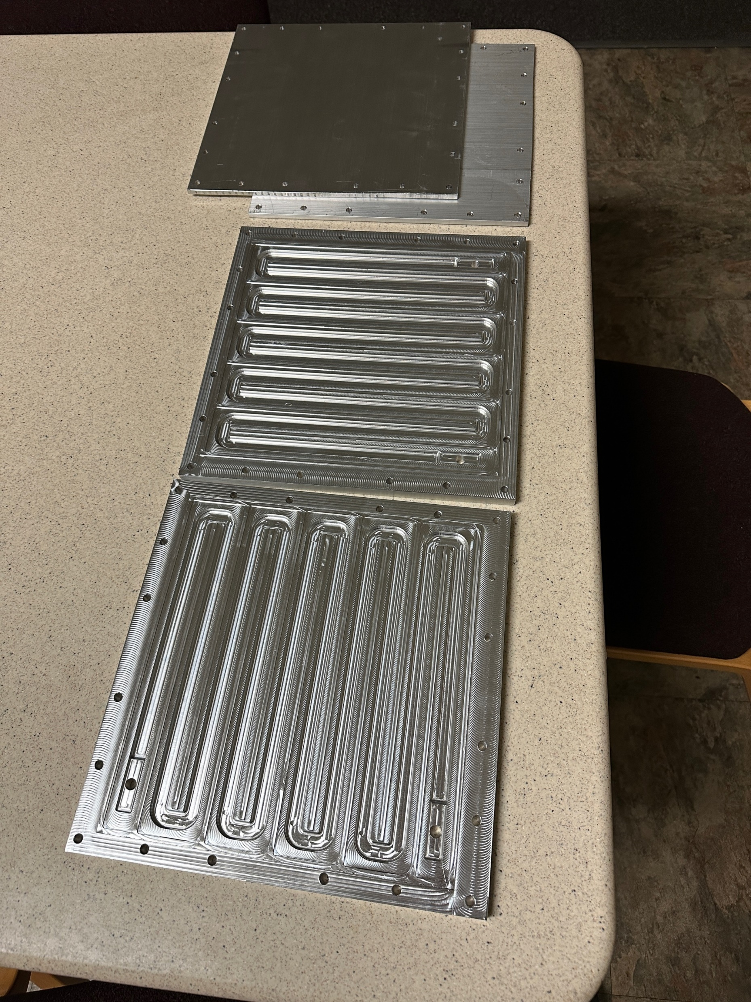
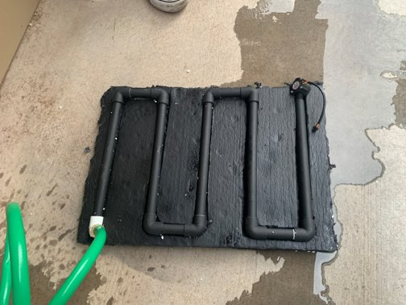
Design Iterations
Prototype Panel
Final Panel
Logan Yeoman - Slide 7

Slide 8
Purchasing Plan
Total of 27 items on the Bill of Materials
  Purchased 85% of the items (23 items)
  50% of the items on hand
  35% of items are in transit
Plan on having 100% ordered before March
  15% of the items have not been purchased (4 Items)
  These items include sensors and a pump

Slide 9
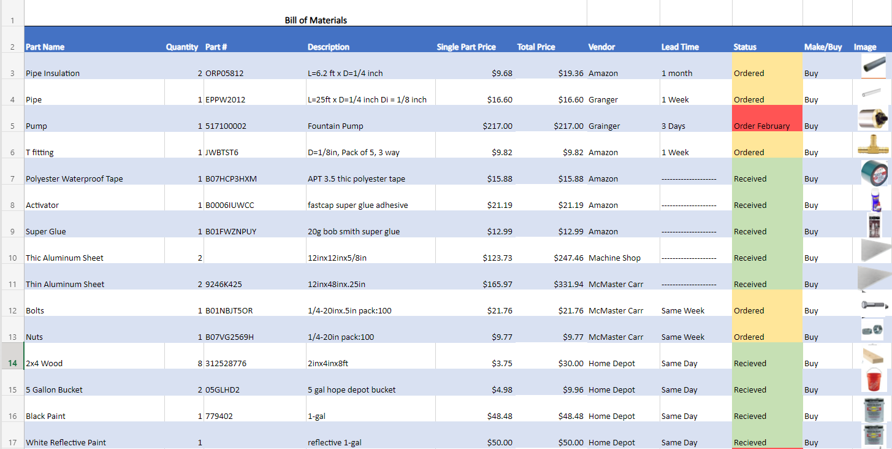
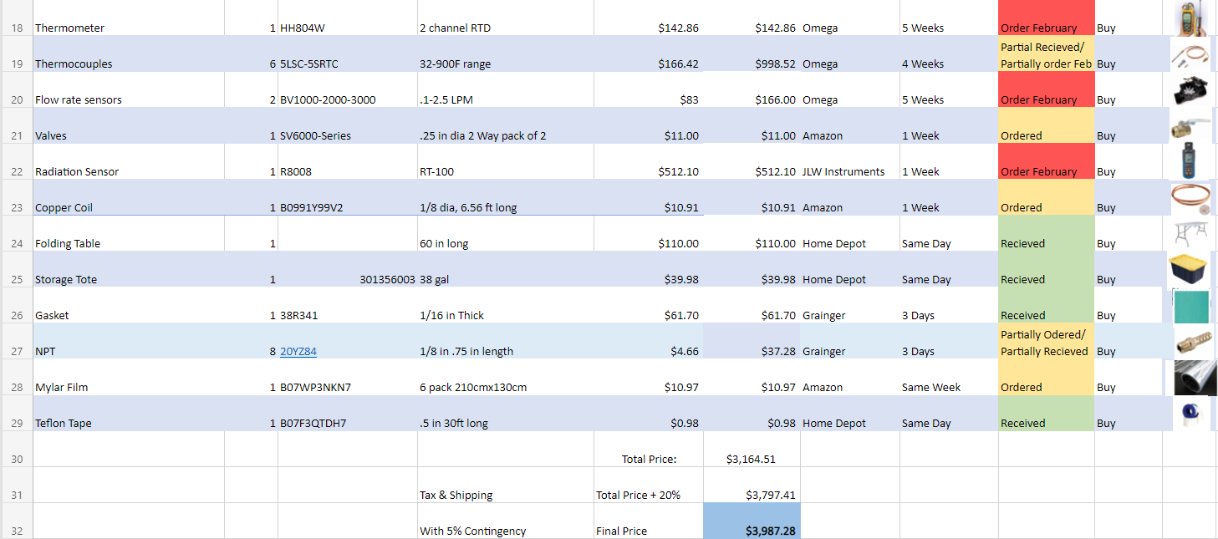
Bill of Materials
Green = Received
Yellow = Ordered
Red = Not Ordered Yet
Longest Lead Time: 5 Weeks (Noncritical)
Total anticipated price including expected shipping and 5% Contingency is about $4000
Initial Budget = $6752.41
  $2000 Capstone
  $4752.41 Green Fund
Current Expenses = $1541.73
Budget Remaining = $5210.68
Sabin Wright - 9

Slide 10
Manufacturing Plan
Currently, two of the panels have been manufactured
  Now that there is proof that they seal, the team has put in a work order for the other two
  One of the panels will be sent this week to DEVELOPER for painting
The team will be assembling the apparatus ourselves
  The team still has to cutting some of the piping
  The team has cut the rubber gasket to its proper size and assembled two of the panels together
5 out of the 10 manufacturing hours has been completed

Slide 11
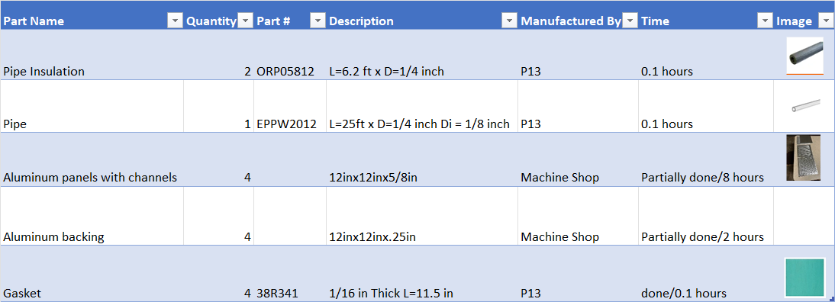
Manufacturing Table
Table 3: Manufacturing Table

Slide 12
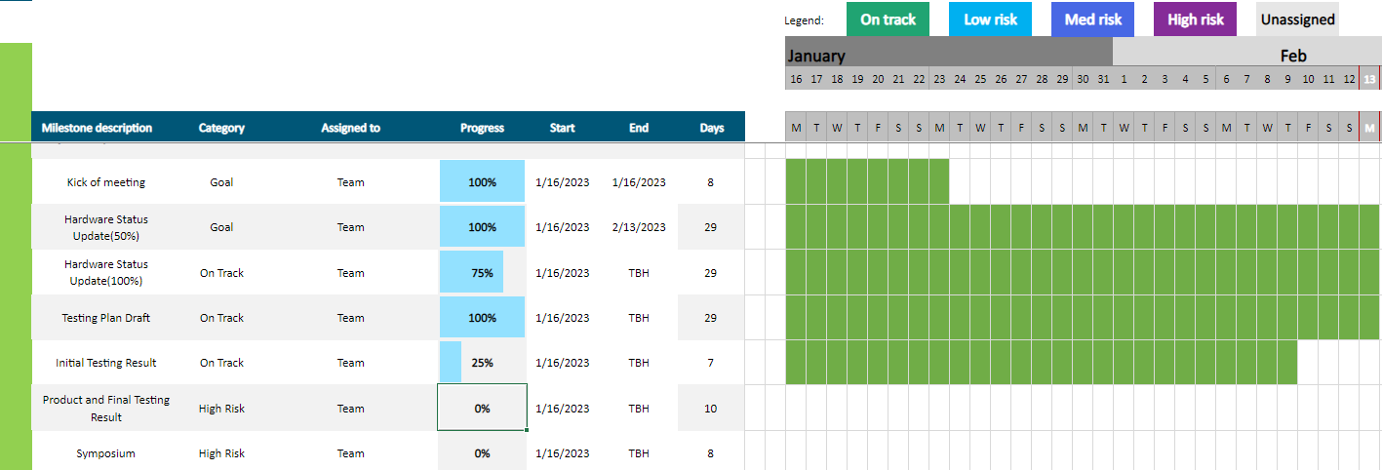
Schedule
Schedule Status: Team is ahead off the track schedule.
Major Dates
  Before end of February– Shipping panels to DEVELOPER
  March 6th, 2023 – Second Hardware Status

Slide 13
Testing Plan Draft
Instrumentation
Thermocouples at Panel Inlet and Outlet.
Stopwatch.
Three Buckets with Accurate Volumes.
Calibration
Following the standard thermocouple calibration process which was defined in ME 495 Experimental Methods. Using Ice Water, ambient temperature water, and heated water and comparing those values to a calibrated thermometer.
Ensuring accurate volume measurements using a trusted graduated cylinder.
Testing Parameters
Testing can only be conducted on days with zero cloud cover, ambient temperatures between 32 degrees Fahrenheit and 70 degrees Fahrenheit, and between 10 AM and 4 PM.
Procedures
Record all control variables including ambient temperature, time of day, wind speeds, and cloud cover.
Conduct a series of bucket timer tests to calculate a standard flow rate and ensure all three panels have the same flow rate.
Record the inlet and outlet temperatures every 10 seconds over a 1-hour period.

Slide 14
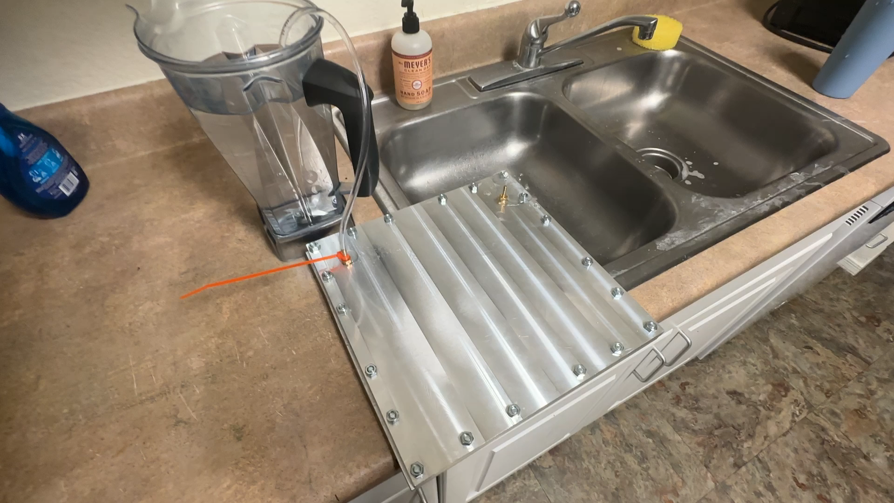
Demonstration Video
Logan Yeoman - Slide 14

Slide 15
Citations
[1] J. Wade. Passive Radiative Cooling, 2022. [ Online]
[2] Bryant, Cari & Stone, Robert & Mcadams, Daniel & Kurtoglu, Tolga & Campbell, Matthew. (2005). Concept generation from the functional basis of design. Proceedings ICED 05, the 15th International Conference on Engineering Design.
[3] SolidWorks, “Drawings Overview,” SolidWorks. [Online]. Available: https://help.solidworks.com/2021/english/SolidWorks/sldworks/c_drawings_overview.htm?id=66c6503edbef4225a997ddc6d5daf8b7#Pg0.
[4] SolidWorks, “Design Studies in SOLIDWORKS,” SolidWorks, 2021. [Online]. Available: https://help.solidworks.com/2021/english/SolidWorks/sldworks/c_Design_Studies_in_SOLIDWORKS.htm?id=49d4a47345e44da38ca59275a0e838cd#Pg0.
[5] M. J. Moran and H. N. Shapiro, Fundamentals of Engineering Thermodynamics, 8th ed. Hoboken, NJ, AZ: John Wiley, 2014.
[6] T. L. Bergman and F. P. Incropera, Fundamentals of heat and mass transfer, 7th ed. Hoboken, NJ, AZ: Wiley, 2011.
[7] F. E. RICHARD S.. BEASLEY, DONALD, Theory and design for mechanical measurements, 5th ed. S.l., AZ: JOHN WILEY & SONS, 2021.
[8] M. Chen, D. Pang, X. Chen, H. Yan, and Y. Yang, “Passive daytime radiative cooling: Fundamentals, material designs, and applications,” EcoMat, vol. 4, no. 1, 2021.
[9] X. DEVELOPER, “Research Services, Open Innovation and Breakthrough Technology,” DEVELOPER, 02-Sep-2021. [Online]. Available: https://www.DEVELOPER.com/.
[10] M. M3, M3 Engineering & Technology, 12-Feb-2021. [Online]. Available: https://m3eng.com/.
[11] S. Mishra, Fundamentals of heat exchanger design. New York, AZ: Scitus Academics LLC, 2016.
[12] D. ASIMAKOPOULOS, Passive cooling of buildings, 1st ed. S.l., AZ: TAYLOR & FRANCIS, 2020.
[13] N. Lu, "An Evaluation of the HVAC Load Potential for Providing Load Balancing Service," in IEEE Transactions on Smart Grid, vol. 3, no. 3, pp. 1263-1270, Sept. 2012, doi: 10.1109/TSG.2012.2183649.
[14] News.nau.edu. 2022. "NAU Green Fund 2020 Student Research Grant accepting student research proposals – The NAU Review." [online] Available: https://news.nau.edu/2020-green-fund-grant/ [Accessed 10 October 2022].
[15] “Data Acquisition System mainframe, 3 slot, DMM, USB/LAN, DAQ97XA series,” TestEquity. [Online]. Available: https://www.testequity.com/product/26958-1-DAQ970A. [Accessed: 10-Oct-2022].

Slide 16
Questions ?

